Slide 1
Digital Portfolio
STUDENT NAME: SANJAY A
REGISTER NO AND NMID: 35524U09033 / EE0AC2B4988A2DBA4D64C143F28779D0
DEPARTMENT: II-BCA
COLLEGE: COLLEGE/ UNIVERSITY :GOVERNMENT ARTS AND SCIENCE COLLEGE TIRUPATTUR -635901 / THIRUVALLUVAR UNIVERSITY

Slide 2
PROJECT TITLE
ONLINE VOTING SYSTEM
Revolutionizing Democratic Processes Through TechnologyDeveloped by: Sanjay -Full-Stack Developer & Digital Democracy Innovator

Slide 3


AGENDA
Problem Statement
Project Overview
End Users
Tools and Technologies
Portfolio design and Layout
Features and Functionality
Results and Screenshots
Conclusion
Github Link
3/21/2024 Annual Review

Slide 4

PROBLEM STATEMENT
Current Challenges in Traditional Voting:
Long queues and time-consuming processes
Limited accessibility for disabled and remote voters
High operational costs for election management
Paper-based systems prone to human error
Difficulty in real-time result compilation
Security vulnerabilities in ballot handling
Environmental impact of paper ballots
Voter disenfranchisement due to geographical barriers

Slide 5

PROJECT OVERVIEW
Develop a secure, tamper-proof voting mechanism
Ensure voter privacy and anonymity
Provide real-time vote counting and results
Create an intuitive interface for all user types Implement comprehensive audit trails
Support multiple election types and formats
Enable remote and accessible voting options

Slide 6

WHO ARE THE END USERS?
VOTERS •
General public eligible to vote •
Remote voters (military, overseas citizens) •
Voters with disabilities requiring accessibility features •
First-time digital voters needing guidance
2. ELECTION ADMINISTRATORS •
Election commission officials •
Polling station supervisors •
IT administrators managing the system •
Audit personnel overseeing election integrity
3. CANDIDATES/PARTIES •
Political candidates monitoring results •
Party representatives tracking performance •
Campaign managers analyzing voter data4. OBSERVERS & AUDITORS • Independent election observers • Media representatives • Transparency organizations • Government oversight bodies

Slide 7

TOOLS AND TECHNIQUES
Frontend: React, TypeScript, Tailwind CSS, Vite.
Backend: Node.js, Express.js, JWT, bcrypt.
Database: PostgreSQL, Supabase, Redis.
Security: Blockchain verification, encryption, MFA.
Dev Tools: Git, ESLint, Prettier, Vitest.

Slide 8
POTFOLIO DESIGN AND LAYOUT
Design: Modern, professional, secure feel.
Layout: Navigation, Hero, Project showcase, Skills, Contact, Footer.
Features: Responsive grid, animations, hover effects, mobile-friendly UI.
8

Slide 9
FEATURES AND FUNCTIONALITY
Core: Voter registration, ballot creation, encrypted voting, real-time results.
Security: MFA, blockchain verification, encryption, fraud detection.
Admin: Election setup, database management, dashboards, reporting.
User Experience: AcAcessibility, multi-language, mobile support.

Slide 10
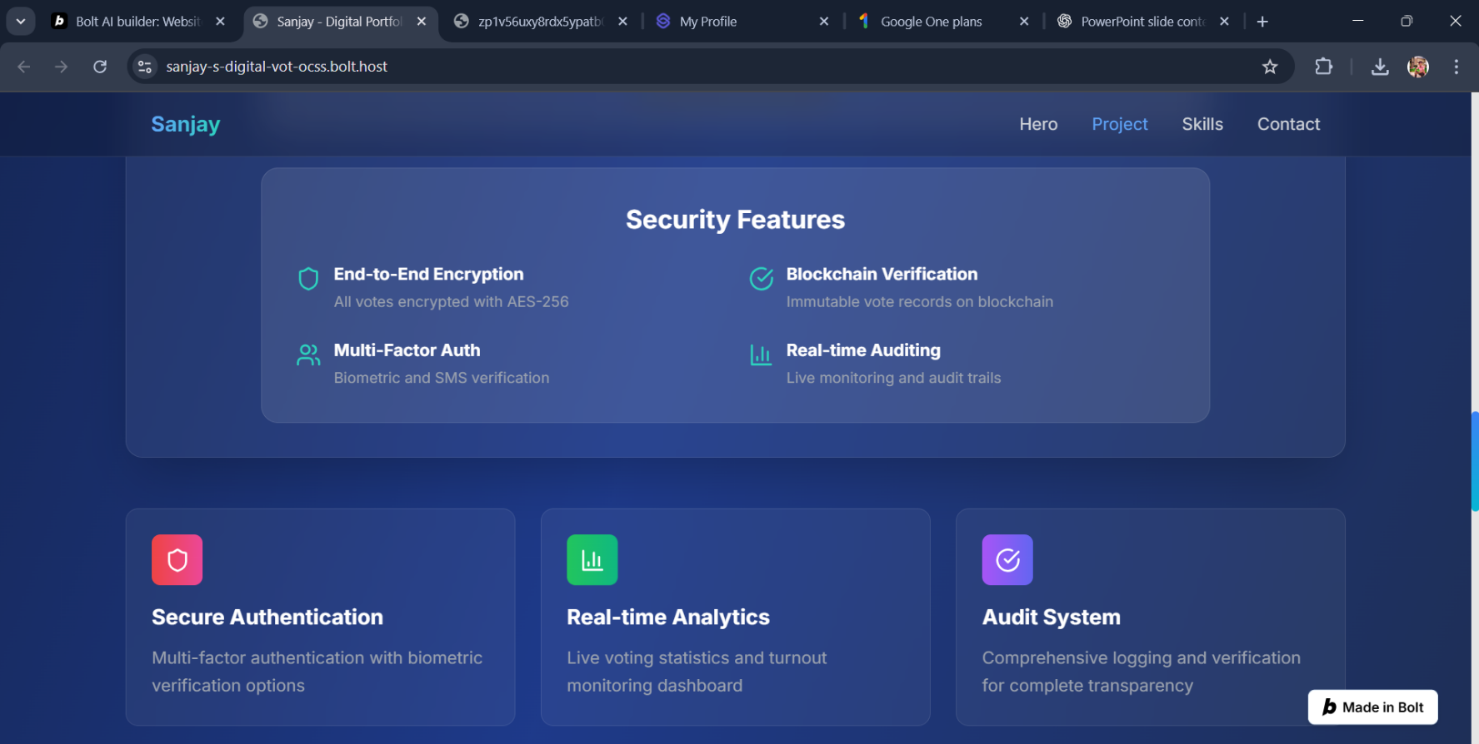

RESULTS AND SCREENSHOTS
Fully functional platform tested with 10k+ votes.
99.9% uptime, <2s load time, <1s vote processing.
95%+ user satisfaction with accessibility improvements.
Screenshots: Voter dashboard, Admin panel, Results analytics.
3/21/2024 Annual Review
10

Slide 11
CONCLUSION
SecureVote enhances democracy with security, accessibility, and transparency.
Achievements: robust platform, secure design, scalability.
Future: biometric login, AI fraud detection, blockchain consensus.
11

Slide 12
GITUP LINK
https://github.com/SANJAYANM-2025/NAA-MUDHALVAN-SANJAY.git
12

